Slide 1
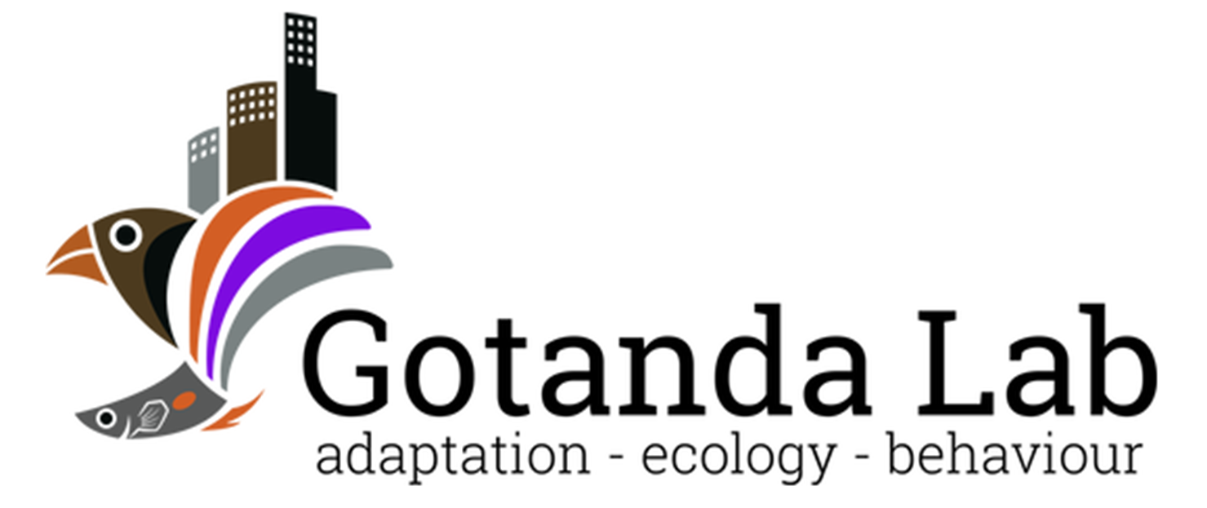

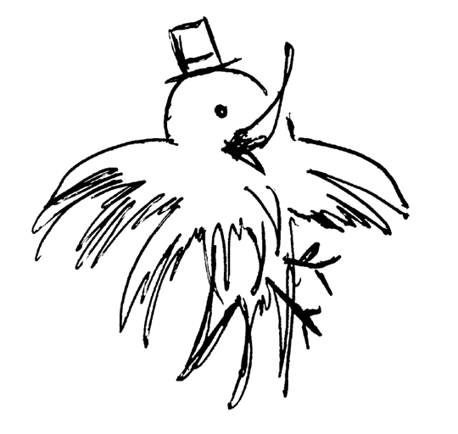
Sentinel Behaviour and Urban Environments:
A Corvid’s Perspective
Alex Popescu
Thesis Defense – September 9th, 2024
Brock University

Slide 2

Sentinel behaviour in mammalian and avian species
Alex Popescu, Dr. Kiyoko M. Gotanda
Department of Biological Sciences, Brock University
GRaD 2024

Slide 3







Notes:
Explain “rules” of the game first
- You get points for staying alive the longest
- You need to eat, otherwise you get penalized, and eventually die

Slide 5
An important trade-off
Two mutually exclusive requirements; too much of either is unfit
↑ Satiation
↑ Risk of predation
↑ Safety
↑ Risk of starvation
Foraging
Vigilance

Slide 6
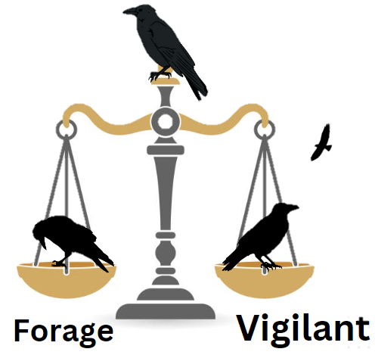
Finding the balance
A difficult task that depends on:
Intrinsic factors
Energetic reserves, sex
Extrinsic factors
Risk, environment
Certain species have behaviours that facilitate this decision

Slide 7
Notes:
Now you’re playing multiplayer:
- More individuals, can share the task between individuals
- In the best of cases, the task is COORDINATED, where gaps between individuals are minimized

Slide 8


Notes:
In the case of sentinel behaviour, the task is given to one individual at a time, constant vigilance

Slide 9
Sentinel behaviour
A form of coordinated vigilance:
- Sentinel loses foraging opportunities.
- Can result in increased safety and food intake in foragers.
Why do sentinels perform the behaviour if it is costly?

Slide 10
Objective
How can intrinsic and extrinsic factors affect sentinel decision-making?

Slide 11

Selfless or selfish?
Sentinel behaviour was originally thought to be a selfless behaviour.
↑ Foraging efficiency
↓ Predation risk
Lost foraging opportunity
Sentinel
Forage
Costs of sentinel behaviour compensated by the actions of other sentinels.

Slide 12





Selfless or selfish?
More recently, empirical studies support the selfish, state-dependent model for sentinel behaviour.
Sentinel present
Sentinel Absent
Decision to perform sentinel behaviour dependent on individual’s energetic state & need for safety.
Lost foraging opportunity
↑ Risk
Earlier threat detection

Slide 13
Decisions, decisions…
This decision could be affected by intrinsic and extrinsic factors.
Sentinel present
Sentinel Absent
Understanding the effects and interactions between these factors can provide insights into the decision-making of similar behaviours.
Lost foraging opportunity
↑ Risk
Earlier threat detection

Slide 14
Methods
We searched Web of Sciences on Nov. 1st, 2022
- “Sentinel AND Behavio*” as keywords
- Filtered by major concepts
Inclusion criteria:
Must be experimental
Model species must be vertebrate and not aquatic
Must be published after 1970
Must be related to animal behaviour
Must look at intra-specific sentinel behaviour

Slide 15
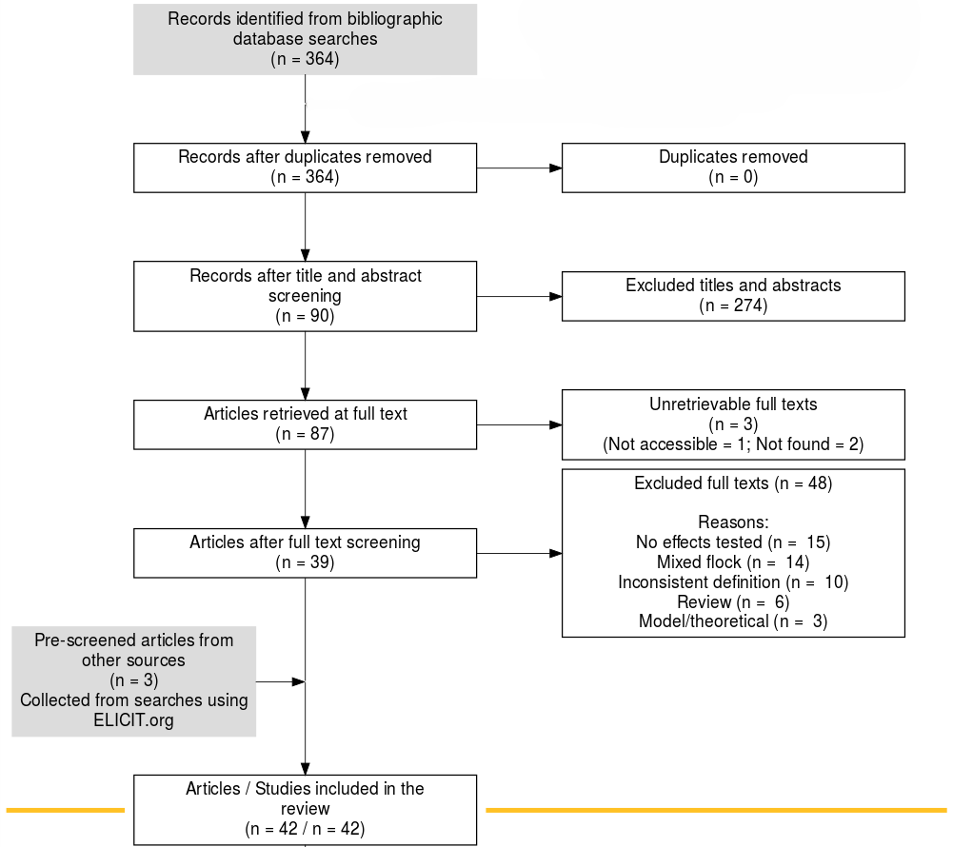
Search Results
Search string returned 364 records.
After screening, we retained 42 studies that fit our inclusion criteria.

Slide 16
Trends observed
The effects of several intrinsic and extrinsic factors were common in both mammalian and avian species, including:
Intrinsic factors such as sex, body mass, and satiation
Extrinsic factors such as dominance, group size, and risk
Many factors are energy-related.
An interaction between sex and dominance was often reported.

Slide 17






Energy-related factors
Factor | Highest contribution | Lowest Contribution
Sex
Body mass
Satiation
Group size

Slide 18

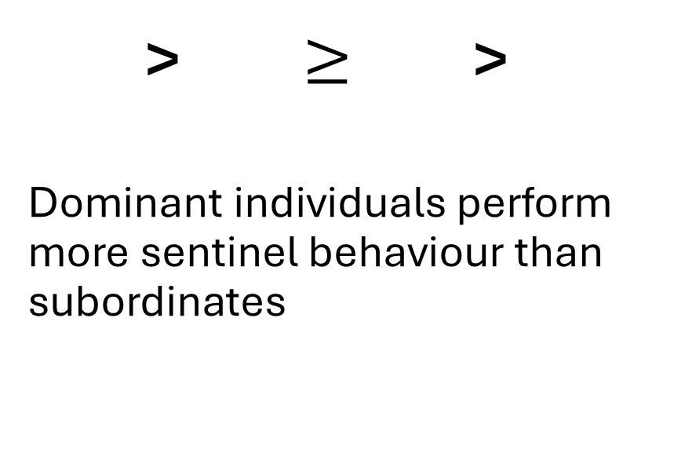
Dominance
> $≥$ >
Dominant individuals perform more sentinel behaviour than subordinates
Sentinel present
Sentinel Absent
Lost foraging opportunity
↑ Risk
Could be energy-related but also be a result of different benefits provided by the behaviour
Earlier threat detection

Slide 19
Risk
The greater the risk, the greater the incentive to be a sentinel.
e.g. The presence of predators results in increased sentinel efforts
Sentinel present
Sentinel Absent
Lost foraging opportunity
↑ Risk
Earlier threat detection
Surprisingly, the presence of outgroup rivals also increased sentinel efforts…

Slide 20
Non-antipredator benefits
The sentinel’s perch provides good visibility over a large area.
This could provide non-antipredator benefits to certain individuals:
Territory defense
Mate guarding
Sentinel present
Sentinel Absent
Lost foraging opportunity
↑ Risk
Earlier threat detection

Slide 21
Objective
How can intrinsic and extrinsic factors affect sentinel decision-making?
Energetic availability ↑ = ↑ Sentinel behaviour
Risk ↑ = ↑ Sentinel behaviour
Habitat can affect these factors, in turn affecting the behaviour
- e.g. natural vs. urban environments
Behaviours can also be modified to best suit the individual’s habitat

Slide 22
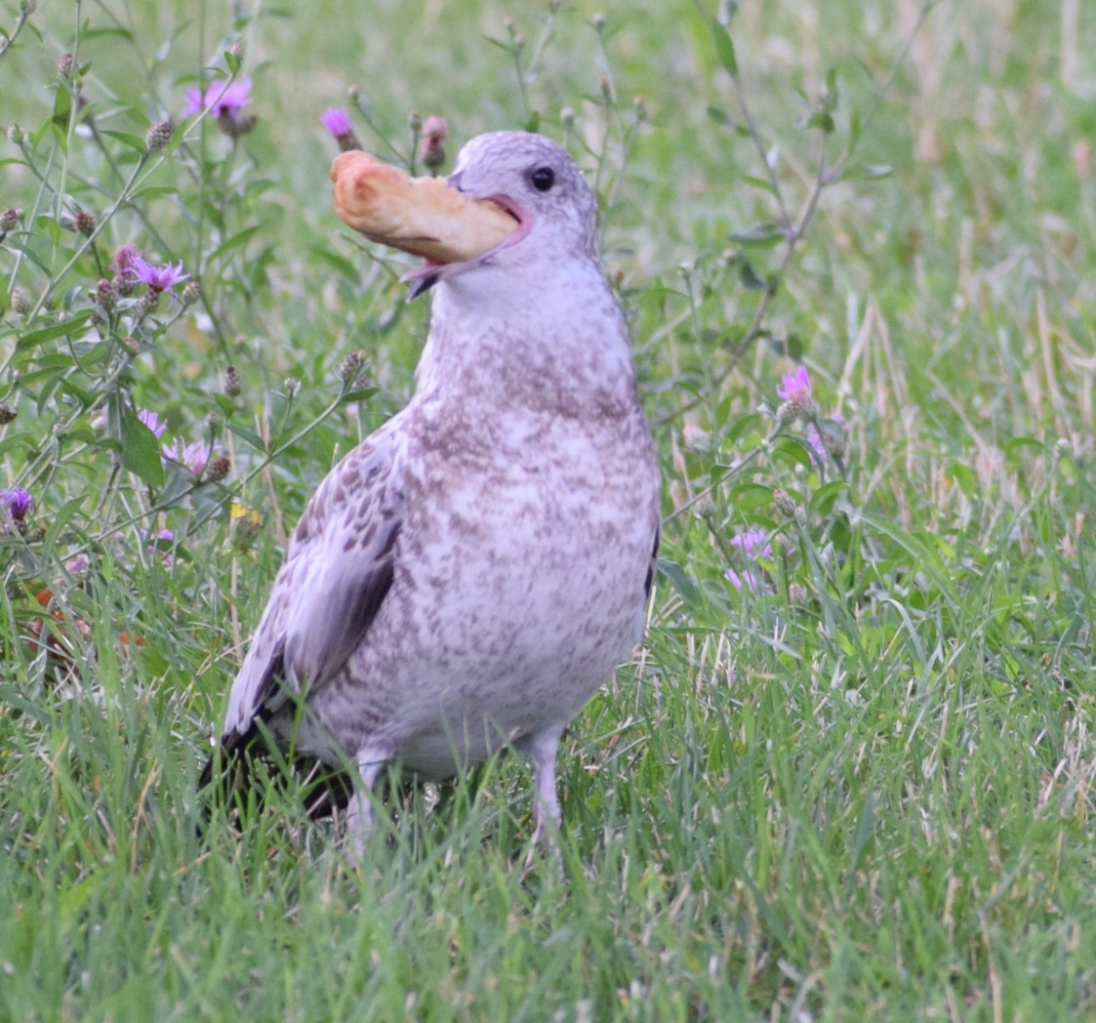
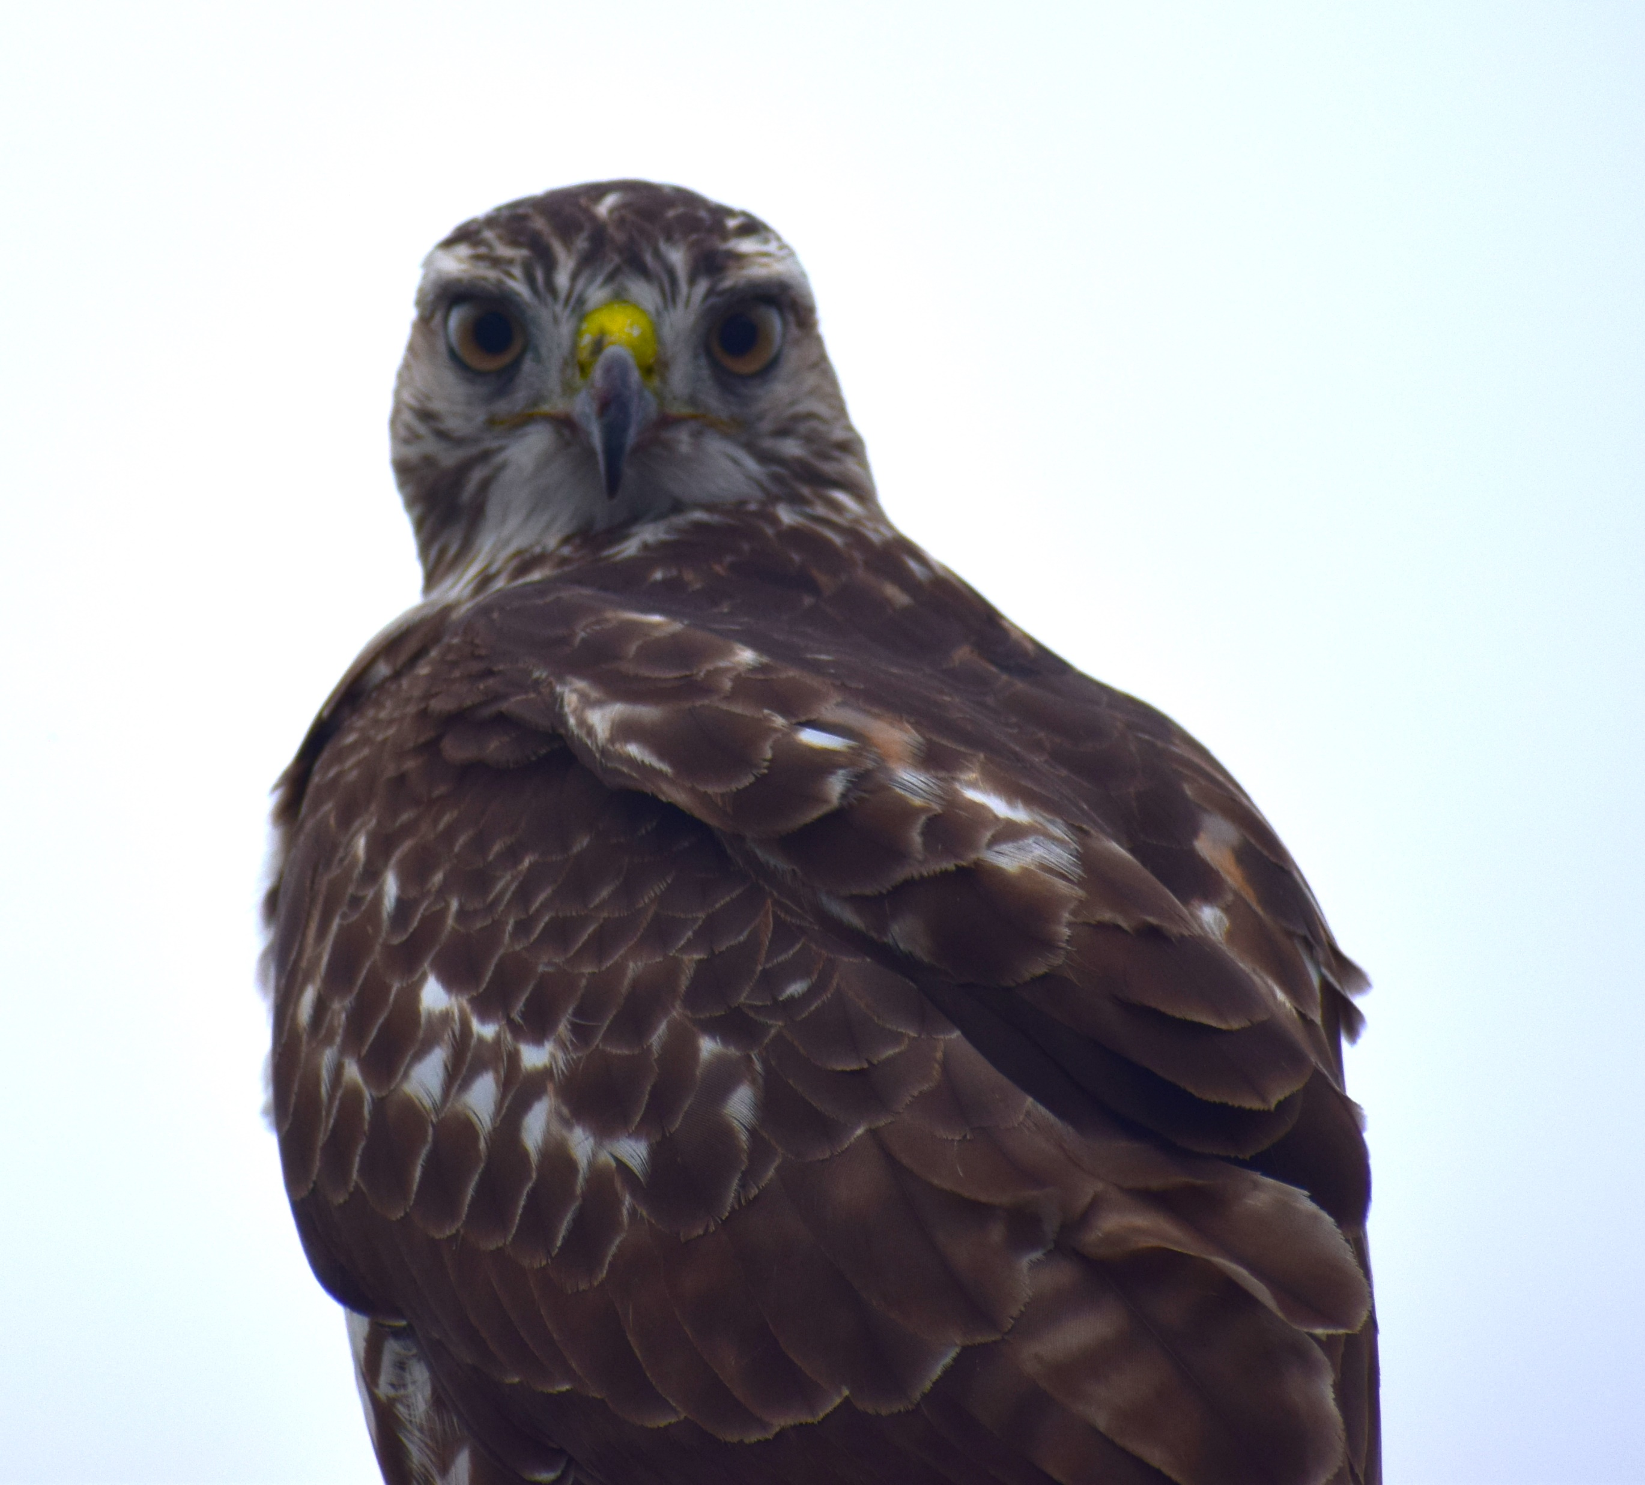
Sentinel behaviour and urban environments
Anthropogenic resources
Urban predators
Human interaction
Future research is required to build upon my findings.

Slide 23
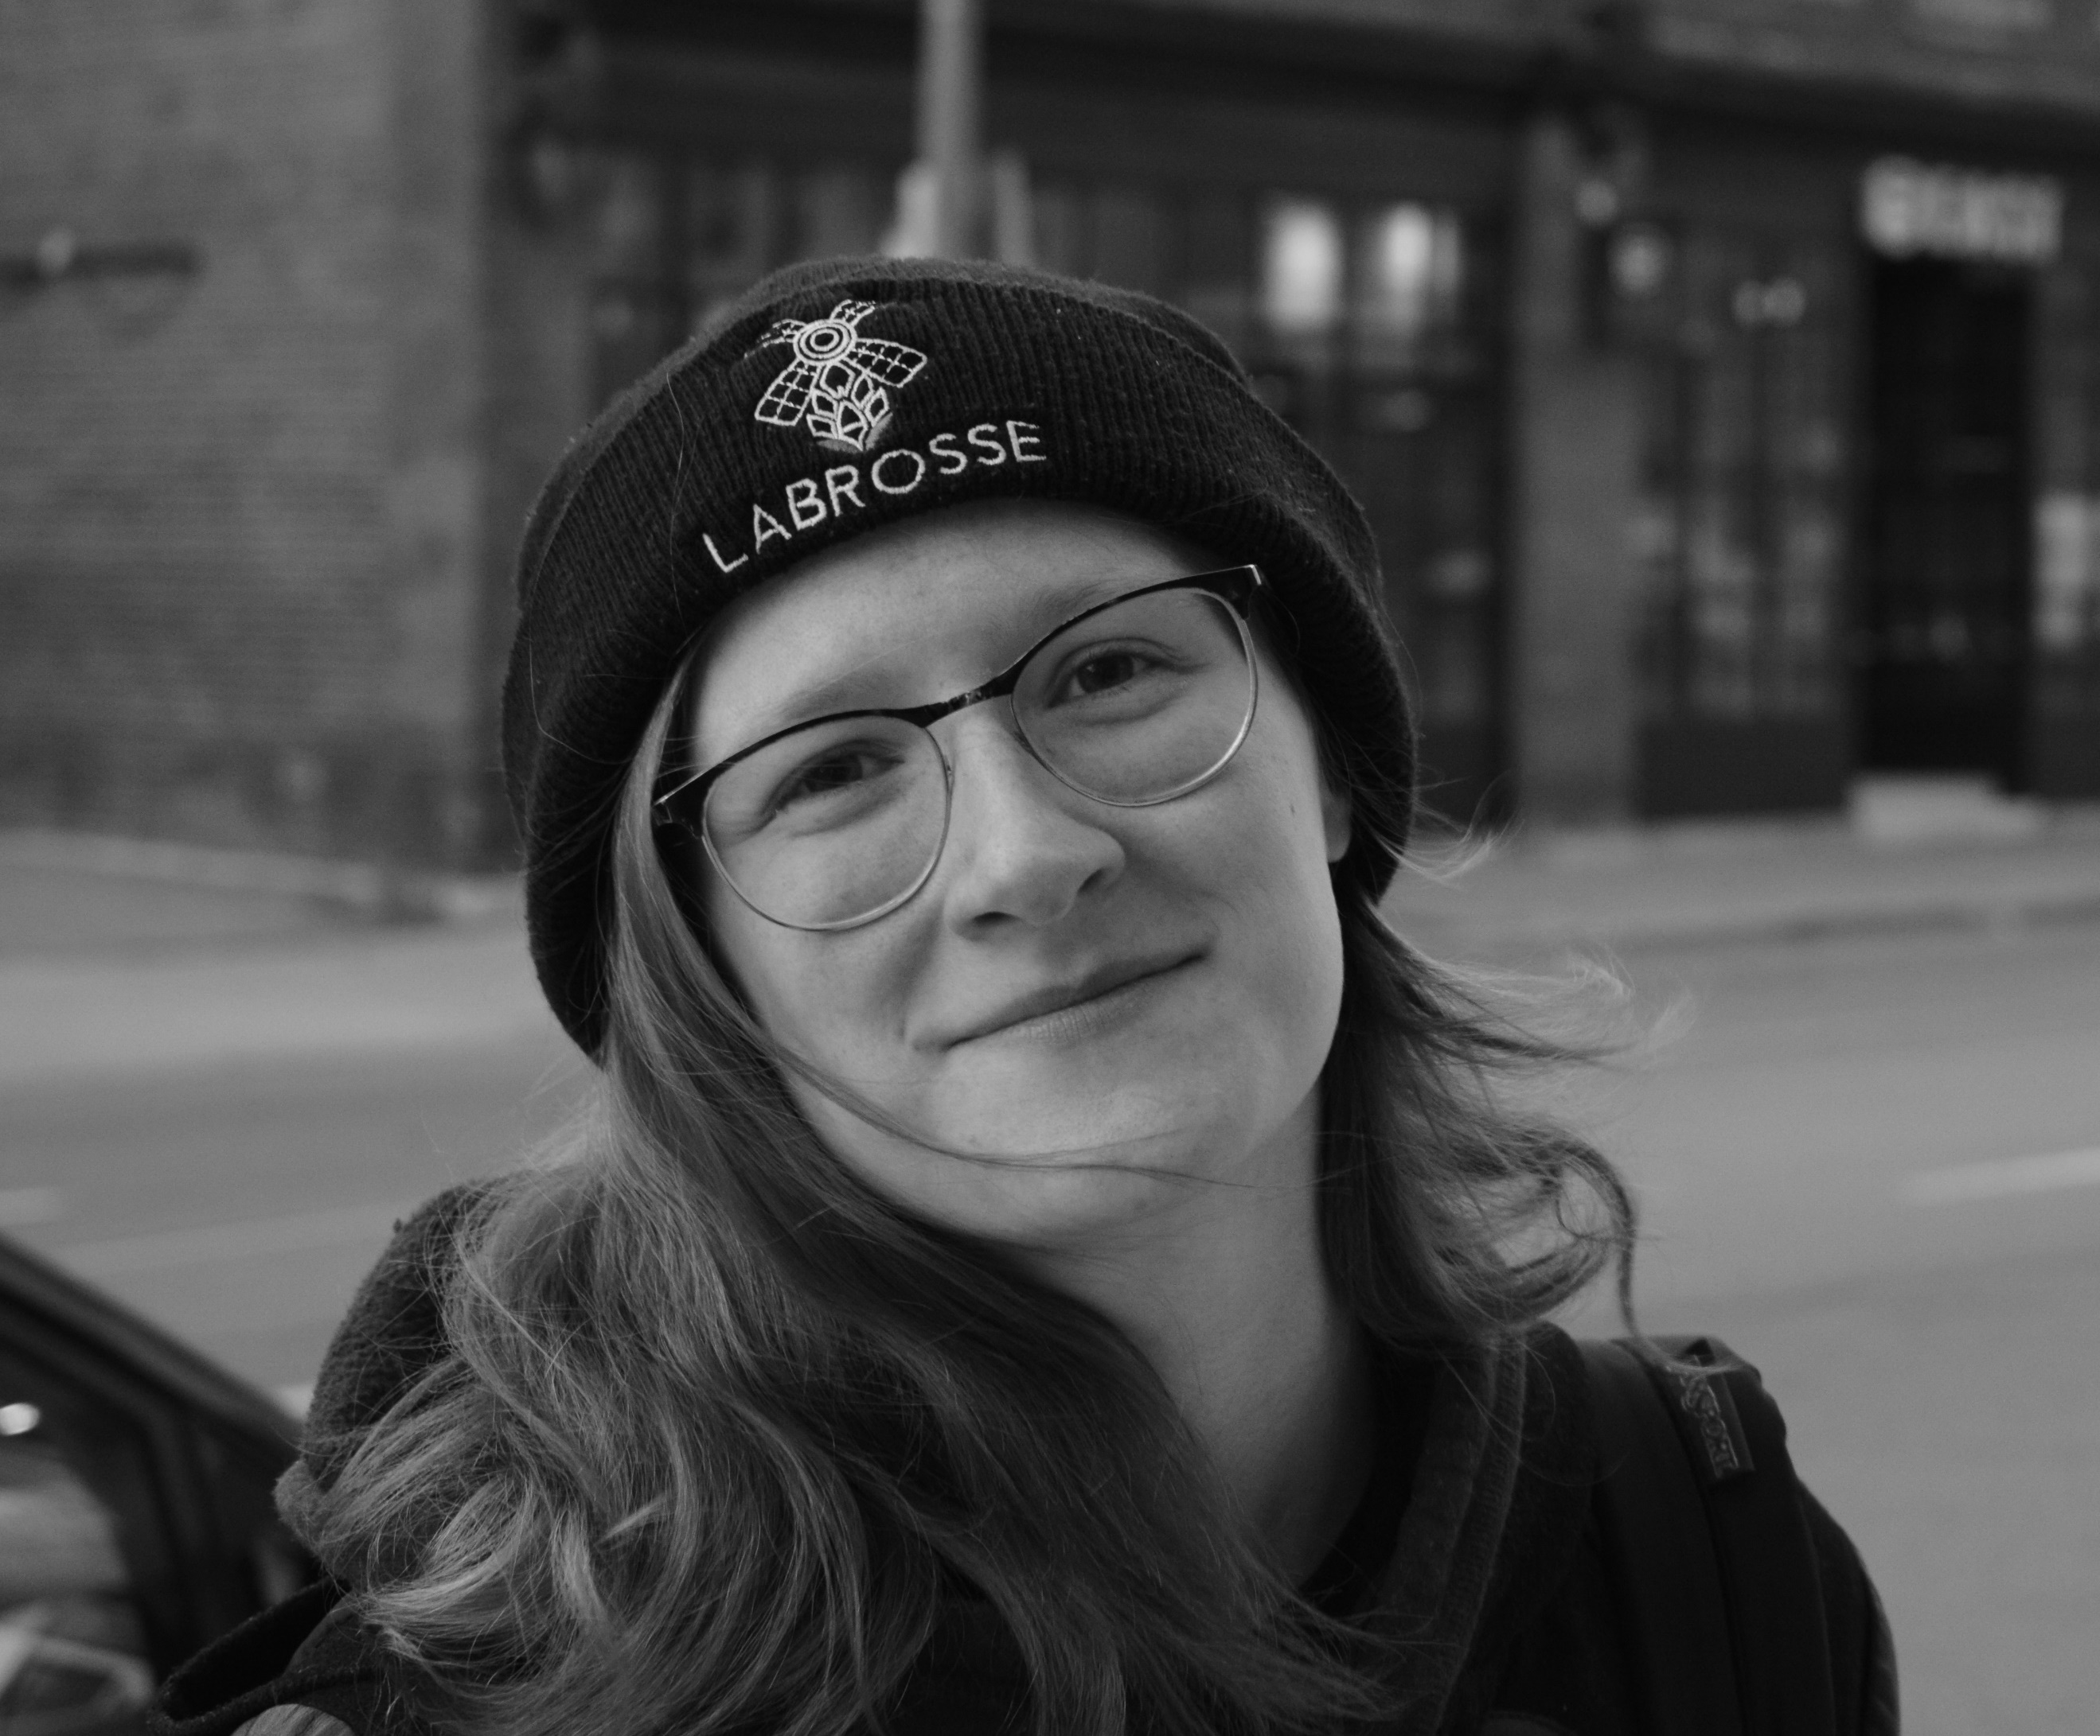
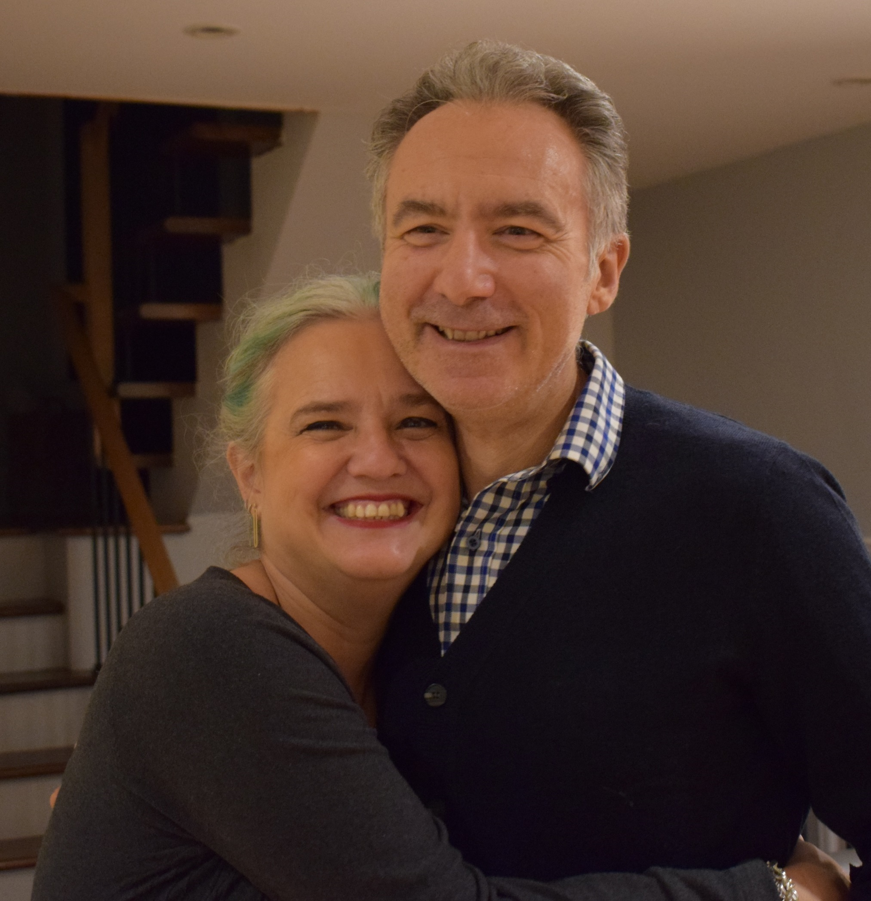
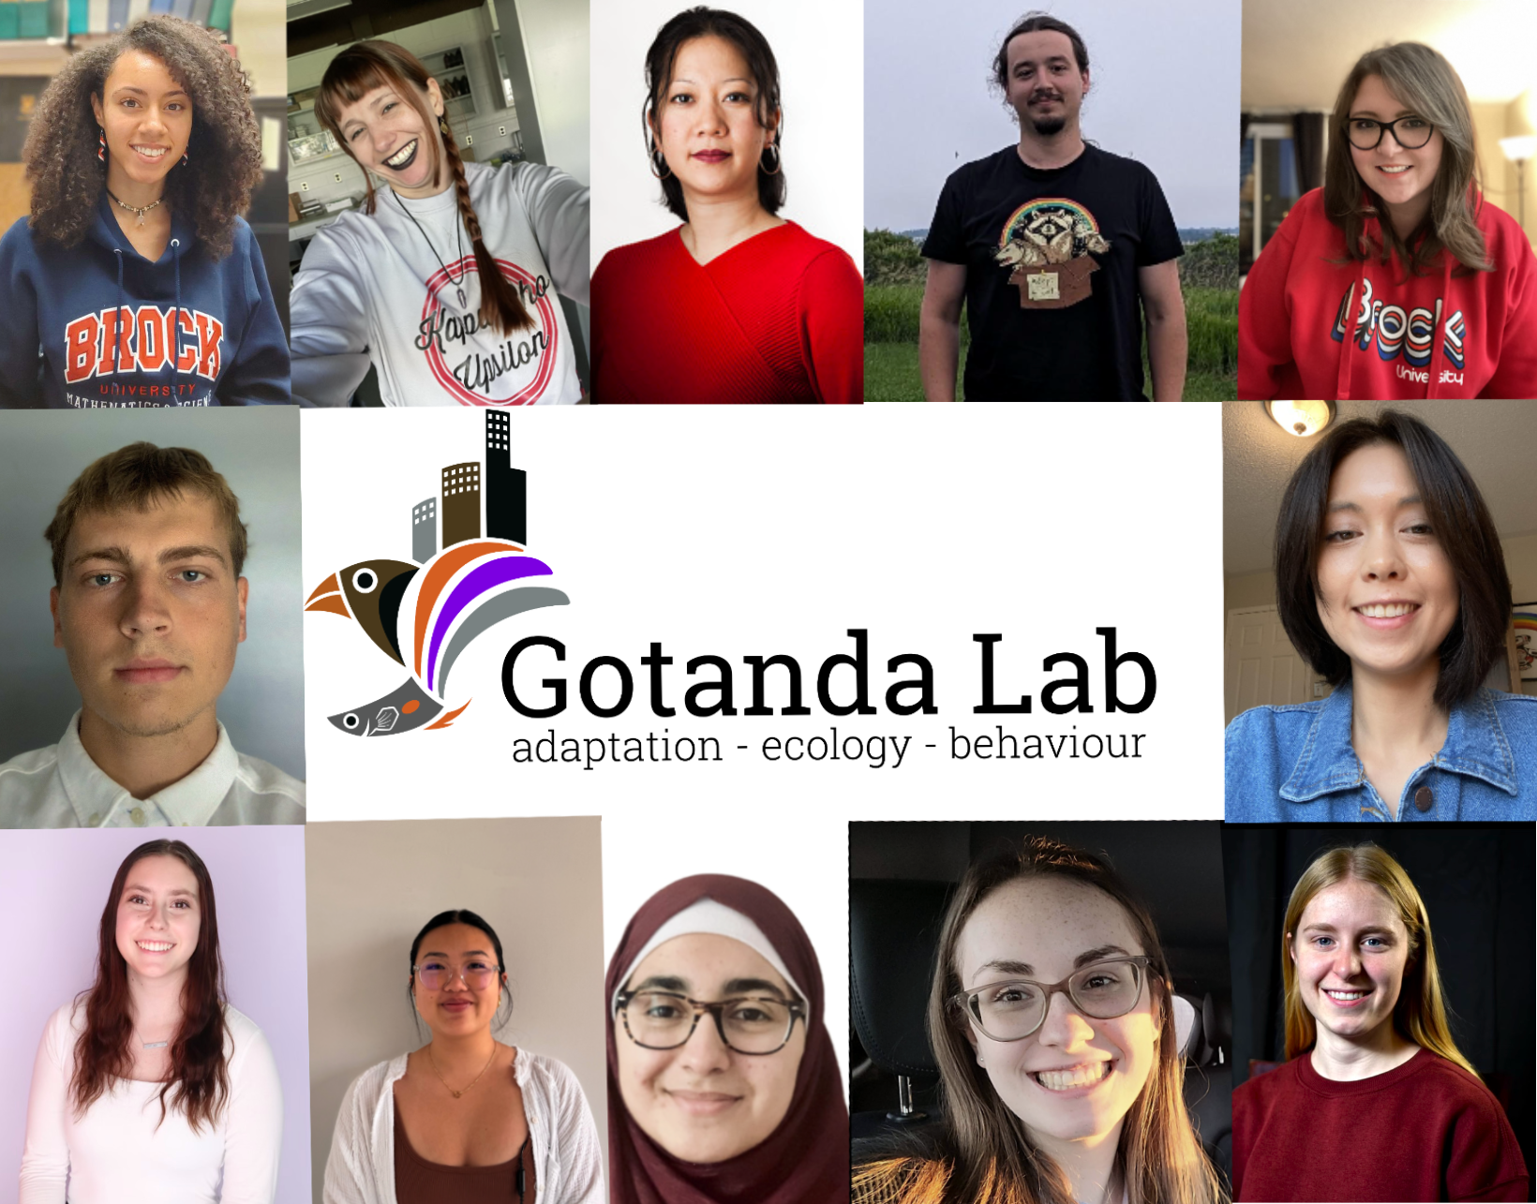


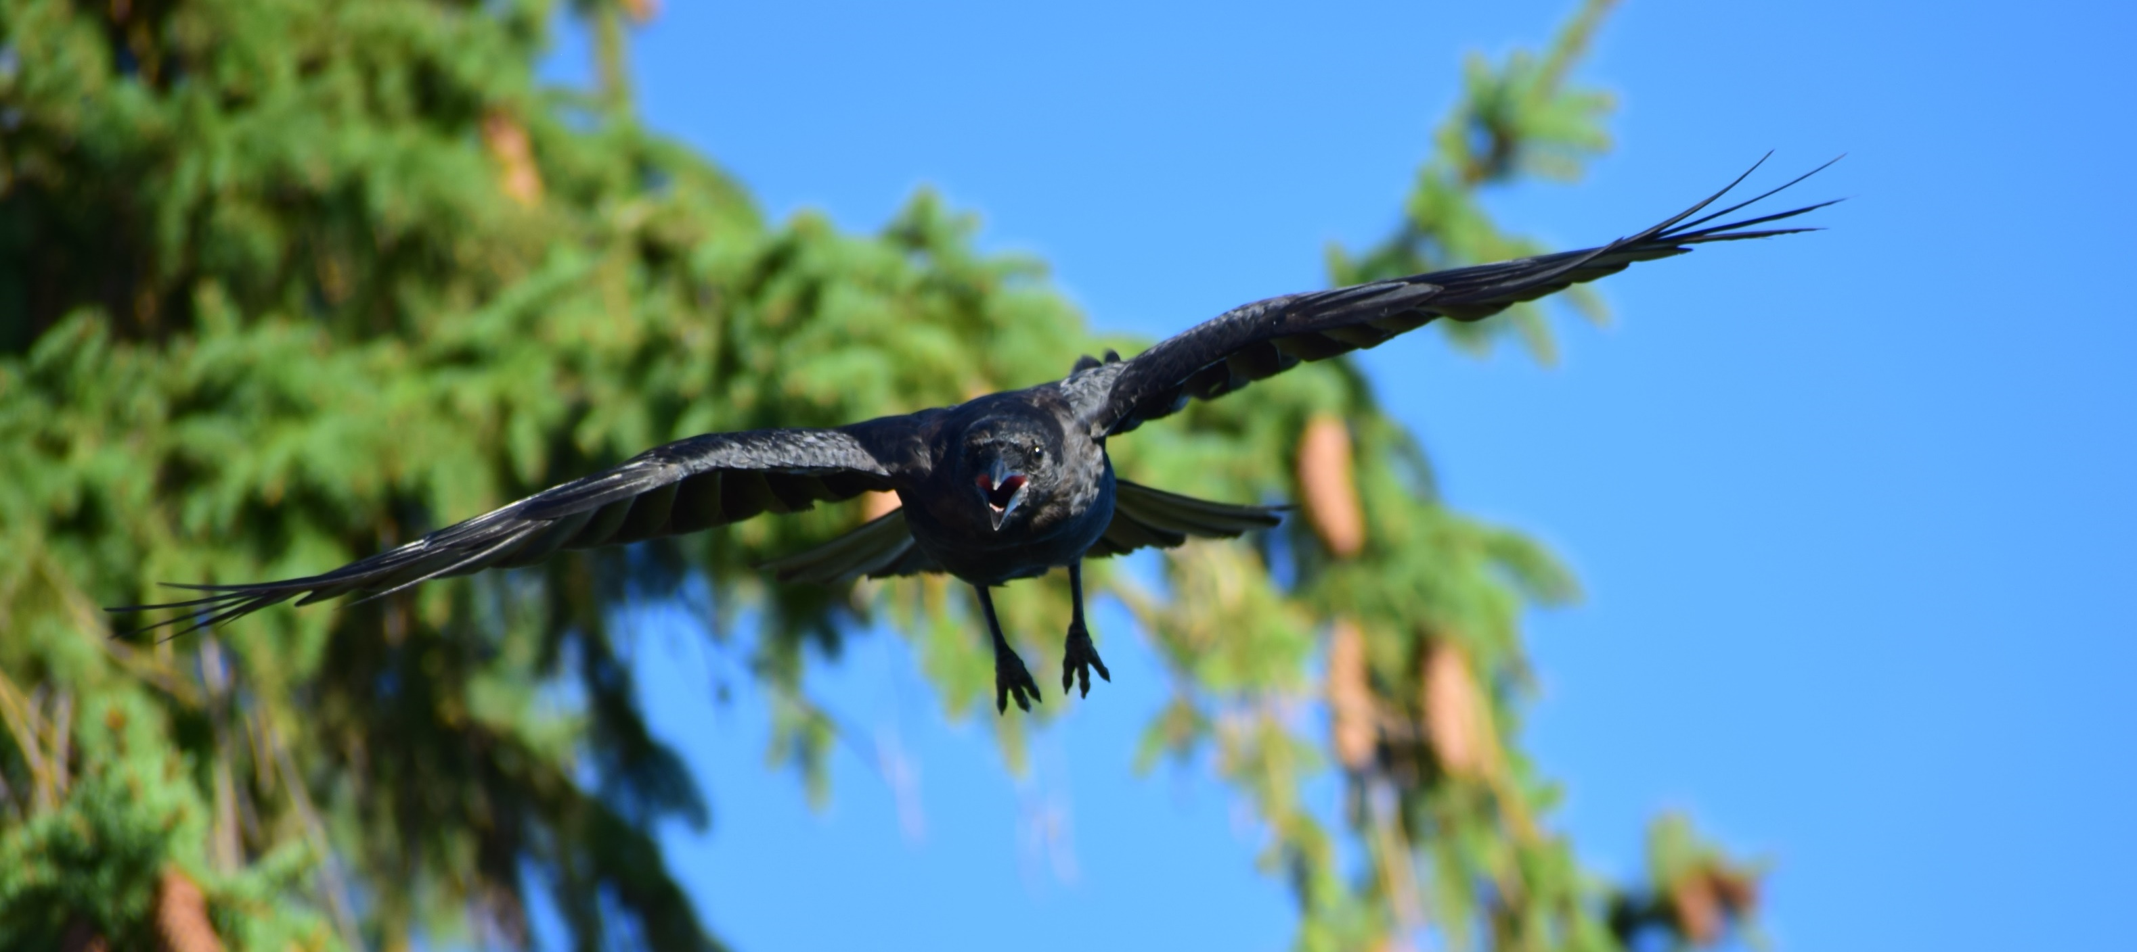
Acknowledgements
Notes:
Funded by Brock, no need to mention explicitly. Thank funding sources at a defense (which this isn’t)

Slide 24
Questions?

